Slide 1

Factors Influencing Sleep Quality Among University Students and Strategies to Tackle the Problem
Group 6
2024.1.4
Group Leader: Wang Jian-ge
Group Members: Liu Shuyi, Chen Shuxuan, Lin Jishen, Shao Renfei

Slide 2
1
Introduction and Review
Contents
2
Methodology and Model
3
Results and Strategies

Slide 3

Section One
1
Introduction and Review

Slide 4

1 Introduction and Review
1.1 Background
01
Increasingly highlighted Sleep quality research
02
Fast-paced, stressful modern lifestyles
03
Undergraduates’ academic anxiety and psychological stress

Slide 5

1 Introduction and Review
1.2 Overview
Overview of Sleep Quality
Sleep quality —— a multidimensional concept influenced by various factors
1
Overview of Research Methodology
2
Data collection, preprocessing quantification of sleep-related parameters

Slide 6
1 Introduction and Review
1.3 Review of Factors
use of energy drinks and coffee
01
FACTORS
06
poverty, majors and other potential factors
02
05
lack of physical activity
unreasonable course schedules
03
04
high screen time
mental health status

Slide 7


1 Introduction and Review
1.4 Cover the Whole Content
Study Framework and Approach
Overall structure and approach, Use of PSQI, Self-designed questionnaires, and stratified sampling method.
Research Objectives
Identifying influential factors, Analyzing sleep quality, Proposing targeted improvements.
Comparative Analysis and Significance
The evolving trends, Broader significance of addressing sleep deficiency among university students.

Slide 8
Section Two
2
Methodology and Model

Slide 9
2 Methodology and Model
2.1 Questionaire Design
Pittsburgh Sleep Quality Index
01
PSQI
07
duration of sleep
overall sleep quality
02
06
sleep disturbance
daytime dysfunction
03
05
sleep latency
04
use of sleep medicine
habitual sleep efficiency

Slide 10
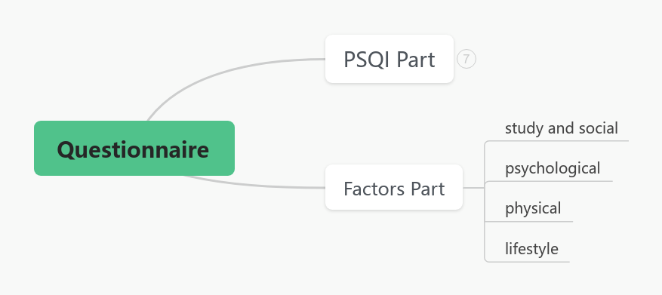
2 Methodology and Model
2.1 Questionaire Design

Slide 11
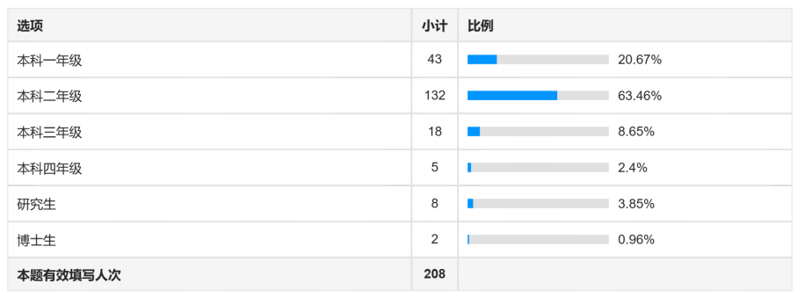
2 Methodology and Model
2.2 Data Collecting

Slide 12
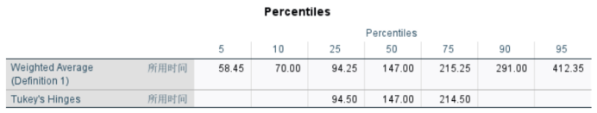
2 Methodology and Model
2.2 Data Collecting
Table: The percentage of time of questionnaire filling

Slide 13
2 Methodology and Model
2.3 Data Qualification
Variable name | Variable declaration | Type | Encoding
S1 | study pressure | Multi-class | 0 - low 1 - general 2 - high 3 - overwhelming
S2 | organization pressure | Multi-class | 0 - low 1 - general 2 - high 3 - overwhelming
S3 | social Relationships | Multi-class | 0 – bad 1 - general 2 - good
E1 | emotional conditions before bad | Multi-class | 0 - soft 1 - general 2 - sorrow & anxiety
E2 | emotional fluctuation before bad | Multi-class | 0 - low 1 - general 2 - high 3 - overwhelming
P | physical status | Multi-class | 0 – well 1 - tired 2 - sleep diseases 3 - other diseases
L1 | drinks before bed | Binary-class | 0 - no effect 1 - bad for sleep
L2 | appetite and awareness time after dinner | Multi-class | 0 - proper 1 - full 2 - hungry 3 - stuffed
C1 | sleep environment (sound and light) | Multi-class | 0 - quiet & dark 1 - low & dim 2 - moderate & soft 3 - loud & normal
C2 | screen time in bed | continuation | 0 - no 1 - T<1h 2 - T<2h 3 - T>2h
Variable name | Variable declaration | Type | Encoding
X1 | overall sleep quality | Multi-class | 0 - excellent 1 - good 2 - poor 3 - terrible
X2 | sleep latency | continuation | 0 - t<0.5h 1 - 0.5<t<1.5h 2 - 1.5h<t<2.5h 3 - t>2.5h
X3 | duration of sleep | continuation | 0 - t>8h 1 - 7h<t<8h 2 - 6h<t<7h 3 - t<6h
X4 | habitual sleepefficiency | continuation | 0 - score>90% 1 - 80%<score<90% 2 - 70%<score<80% 3 - score<70%
X5 | sleep disturbance | Multi-class | 0 – never 1 - seldom 2 - sometimes 3 - often
X6 | use of sleep medicine | Multi-class | 0 - never 1 - seldom 2 - sometimes 3 - often
X7 | daytime dysfunction | Multi-class | 0 - never 1 - seldom 2 - sometimes 3 - often
X8 | screen time | continuation | 0 - t=0 1 - t<0.5h 2 - 0.5<t<1.5h 3 - t>1.5h
Table: Quantification of PSQI
Table: Quantification of influencing factors

Slide 14
2 Methodology and Model
2.4 Factors Analysis
Variable name | Variable declaration
S1 | Study pressure
S2 | Organization pressure
S3 | Social Relationships
E1 | Emotional conditions before bad
E2 | Emotional fluctuation before bad
p | Physical status
L1 | Drinks before bed
L2 | Appetite and awareness time after dinner
C1 | Sleep environment (sound and light)
C2 | Screen time in bed
Multiple Linear Regression
Study and Social
Psychological
Sleep quality scores
Physical
Lifestyle

Slide 15
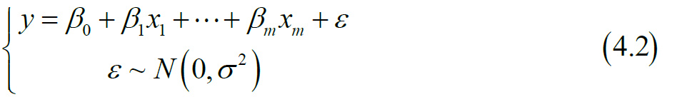
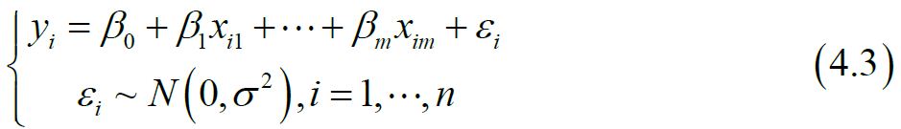
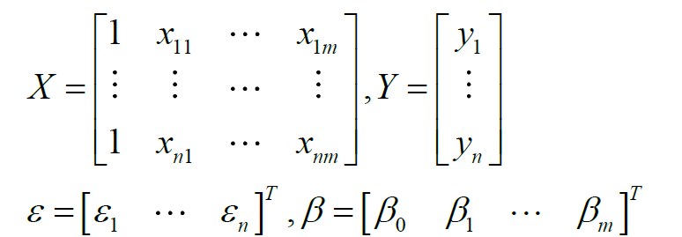
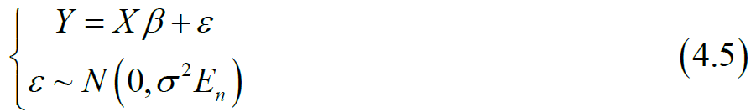
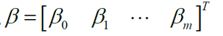
2 Methodology and Model
Multiple linear regression formula:
x: predictor variable
y: response variable
ε: residual
β: regression coefficient
n independent observation data: (yi , xi1,…, xm), i = 1,…, n, n > m
Marked as
Using SPSS to calculate the regression equations
Quantified relationships

Slide 16
2 Methodology and Model
I. The predictor variables are independent of each other, with no multicollinearity.
II. The predictor variables and response variable have linear correlation.
III. The residuals of the response variable satisfy normality.
Three prerequisites to apply the techniques

Slide 17
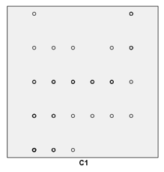
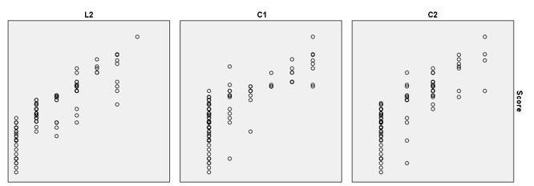
2 Methodology and Model
Scatter plot for prerequisites I, II
For different values of horizontal coordinates, there is no significant change in the distribution of the vertical axis.
I.
Prerequisite I is met.
Predictor variables are independent of each other.
The distribution of the vertical axis varies significantly with the variation of the horizontal axis.
II.
Prerequisite II is met.
Predictor variables and response variable have linear correlation.

Slide 18
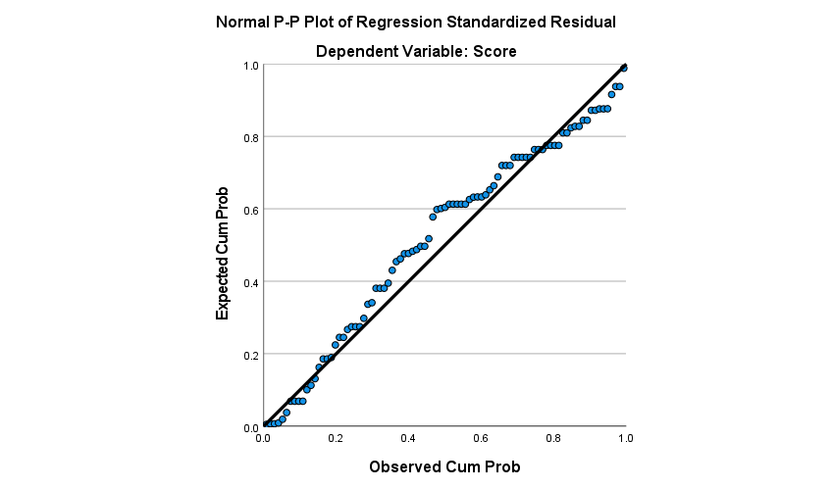
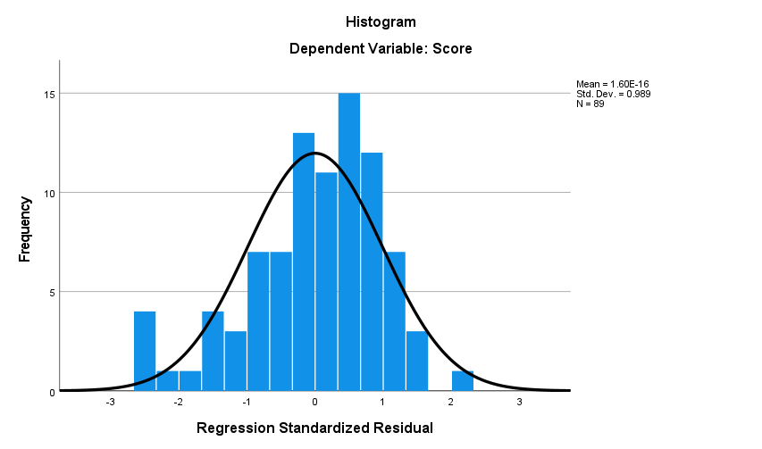
2 Methodology and Model
Histogram and P-P Plot for prerequisite III
If the distribution of blue dots in the p-p plot is located near the straight line and the residual frequency distribution in the histogram is close to a normal distribution, it indicates that prerequisite three is met.
L1 (Drinks before bed) in the lifestyle factors group
S3 (Social Relationships) in the study and social factors group
Through validation

Slide 19
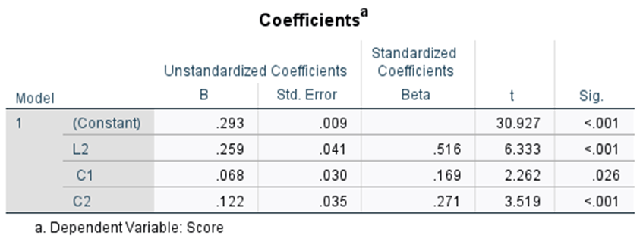
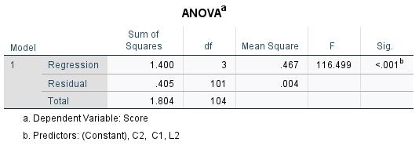
2 Methodology and Model
e.g. Results and Evaluation of lifestyle factors:
Note: integer 0s before the point are omitted from the table
Note: integer 0s before the point are omitted from the table

Slide 20
2 Methodology and Model
Comprehensive adjustments and Final results:
Score= γ₁ ×(score1)+ γ₂×(score2)+ γ₃×(score3)+ γ₄×(score4)
Adjustments:
γ_{i}= n/sum i=1,2,3,4
β | Value
L2 (Appetite and awareness time after dinner) | 0.1935
E1 (Emotional conditions) | 0.18175
S1 (Study pressure) | 0.13175
P (Physical status) | 0.115125
C2 (Screen time in bed) | 0.101625
S2 (Organization pressure) | 0.07325
C1 (Sleep environment) | 0.063375
E2 (Emotional fluctuation) | 0.03375
Table 4.13: results of regression coefficient β

Slide 21
Section Three
3
Results and Strategies

Slide 22





3 Results and Strategies
3.1 Results Analysis
Lifestyle Factors
Psychological Factors
Physical Factors
Social Factors
· Dietary habits
· Sleep environment
· Time spent on
electronic devices
· Emotional state
· Emotional fluctuations
· Physical condition
· Academic stress
· Organizational stress

Slide 23



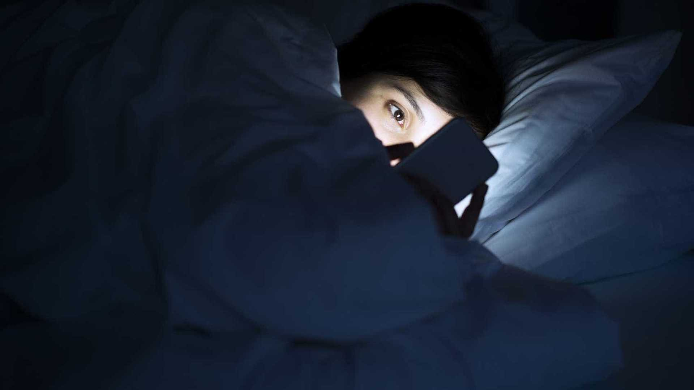

3 Results and Strategies
3.1.1 Lifestyle Factors
Drink Habits (L1) & Dietary Habits (L2)
Post-dinner appetite and activities
Overeating or excessive hunger, post-meal activities' duration
Choice of pre-sleep beverages, like caffeine or alcohol, can disturb sleep
Minimizing fluid intake before bed is beneficial
Electronic Device Usage (L4)
Screen time in bed, especially due to blue light exposure, affects sleep
Disrupts circadian rhythms
Sleep Environment (L3)
Acoustic and lighting conditions-×
A quiet, dark sleep area-√
Noise and light disrupt sleep

Slide 24


3 Results and Strategies
3.1.2 Psychological Factors
Pre-Sleep Emotional State (E1)
Negative emotions before sleep, like sadness and anxiety, lead to poor sleep quality.
Pre-Sleep Emotional Fluctuations (E2)
Inner instability or day-to-day psychological responses.

Slide 25
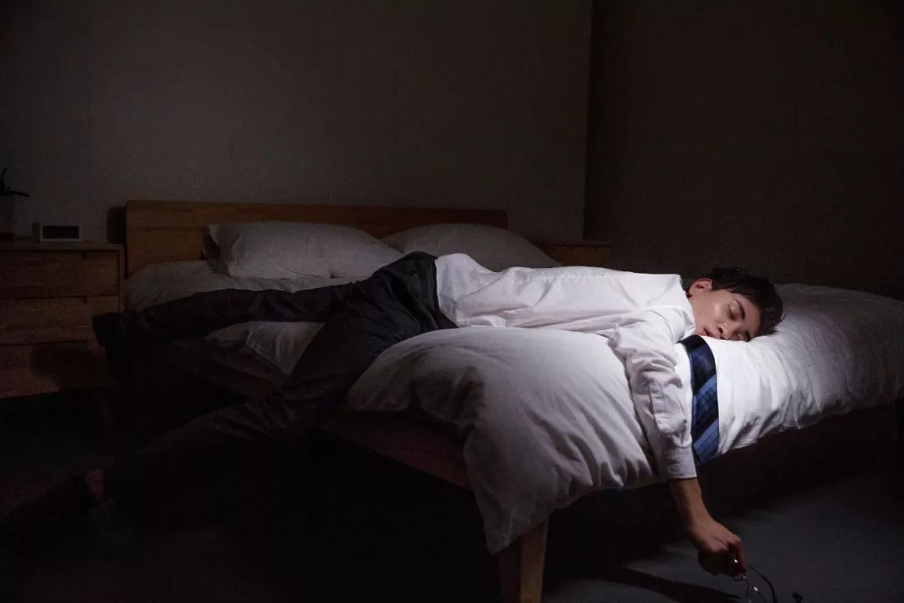
3 Results and Strategies
3.1.3 Physical Factors
Physical Condition and Sleep Quality Correlation
A strong positive correlation exists between physical health (P3) and sleep quality (Score). Poorer physical health leads to poorer sleep quality.
More severe physical issues correlate with higher PSQI scores, indicating worse sleep quality.

Slide 26


3 Results and Strategies
3.1.4 Social Factors
Organizational Stress (S2)
Interpersonal Relationships (S3)
Has a smaller impact on sleep than academic stress, influenced by individual coping and support systems.
No significant direct link between interpersonal relationships and sleep quality, indicating less impact compared to personal psychological states and external stress.
Academic Stress（S1）
Higher stress levels correlate with poorer sleep quality. Academic pressures cause sleep-disrupting anxiety and stress.

Slide 27

3 Results and Strategies
3.2 Strategies to Tackle the Problem
Life and Psychological Factors as key to university students' sleep quality.
Essential steps include:
· improving diet
· managing dormitory environment noise and light
· adopting stress-coping strategies
· maintaining regular sleep and exercise routines
· balancing social and academic life to prevent sleep deprivation

Slide 28


3 Results and Strategies
3.2.1 Social Factor Improvement
Optimizing Social Environment
· Carefully selecting enriching social interactions while reducing stressful or uncomfortable engagements.
· Assertively decline social obligations that may interfere with their restorative sleep periods.
Effective Time Management
Well-defined academic and professional objectives, along with a balanced schedule for work and relaxation, help prevent sleep issues due to overextension or poor planning.

Slide 29

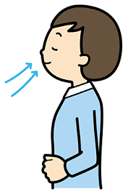

3 Results and Strategies
3.2.1 Social Factor Improvement
Relaxation techniques
These practices reduce stress response activation and promote relaxation, beneficially impacting sleep quality.

Slide 30

3 Results and Strategies
3.2.2 Addressing Physical Factors for Better Sleep
Regular Sleep Schedule & Increasing Physical Exercise
· Consistent sleep habits regulate the circadian rhythm and enhance sleep quality.
· Regular moderate-intensity exercise strengthens the body and alleviates physical fatigue, thereby aiding sleep.
· Addressing negative emotions is crucial, as they can decrease immune function, leading to illness and indirectly affecting sleep.

Slide 31

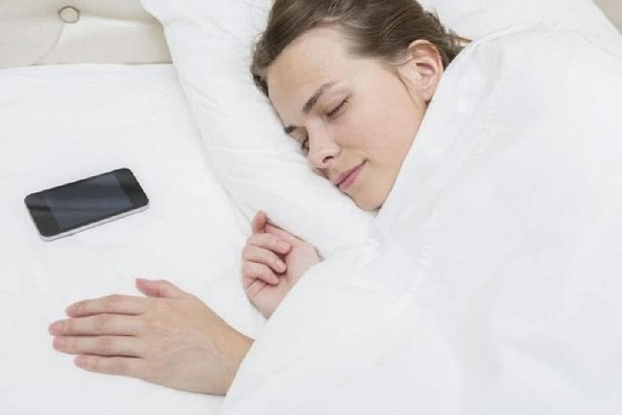
3 Results and Strategies
3.2.3 Enhancing Lifestyle Factors
Dietary Habits
Cultural influences on diet
Intake of greasy, spicy, caffeinated, or sugary foods
Dormitory Environment
Pre-Sleep Smartphone Usage
Using earplugs and eye masks, maintaining appropriate temperature and humidity, and reaching agreements with roommates about noise and light levels are necessary for a comfortable sleep environment.
Reducing smartphone use and addressing mobile phone addiction could improve sleep quality.

Slide 32


3 Results and Strategies
3.2.4 Improving Psychological Well-being
Addressing mental health issues like anxiety and depression through professional help.
Psychological counseling
Psychological therapy

Slide 33

3 Results and Strategies
3.2.4 Improving Psychological Well-being
Mental health, notably anxiety and depression, profoundly impacts sleep quality in college students, affecting their overall well-being and academic performance. Thus, incorporating health behavior theories in interventions is important. Targeted interventions, informed by approaches like the CO-OP method, are crucial for addressing these mental health challenges and improving sleep quality.

Slide 34

Conclusions
This study explores factors affecting university students' sleep, highlighting issues like post-dinner appetite, pre-sleep emotions, academic stress, and dietary habits. The results stress the importance of targeted strategies for enhancing sleep quality by addressing physical, social, and psychological factors.
SLEEP
WELL

Slide 35
Reference
[1] Xu ChuanYi,Zhu KaiTuo,Ruan XiangYan,Zhu XiaoYa,Zhang YangSheng,Tong WenXia Li Bo.(2023).Effect of physical exercise on sleep quality in college students: Mediating role of smartphone use..PloS one(11),e0288226-e0288226.
[2] Doo Miae Wang Chunyang.(2022).Differences in Overweight or Obesity, Changes in Dietary Habits after Studying Abroad and Sleep Quality by Acculturative Degree among Asian Foreign Students: A Cross Sectional Pilot Study.International Journal of Environmental Research and Public Health(9),5370-5370.
[3] Alamir Yahya Ahmed,Zullig Keith J.,Kristjansson Alfgeir L.,Wen Sijin,Misra Ranjita Montgomery Downs Hawley.(2022).A theoretical model of college students’ sleep quality and health-related quality of life.Journal of Behavioral Medicine(6),925-934.
[4] Doo Miae Wang Chunyang.(2022).Differences in Overweight or Obesity, Changes in Dietary Habits after Studying Abroad and Sleep Quality by Acculturative Degree among Asian Foreign Students: A Cross Sectional Pilot Study.International Journal of Environmental Research and Public Health(9),5370-5370.
[5] Khanipour Mahnoosh,Lajevardi Laleh,Taghizadeh Ghorban,Azad Akram Ghorbani Hooman.(2022).The investigation of the effects of occupation-based intervention on anxiety, depression, and sleep quality of subjects with hand and upper extremity burns: A randomized clinical trial..Burns : journal of the International Society for Burn Injuries(7),1645-1652.
[6] Jalali R, Khazaei H, Paveh BK, Hayrani Z, Menati L. The Effect of Sleep Quality on Students' Academic Achievement. Adv Med Educ Pract. 2020 Jul 17;11:497-502.

Slide 36
Reference
[7] Seifert S M, Schaechter J L, Hershorin E R, et al. Health effects of energy drinks on children, adolescents, and young adults[J]. Pediatrics, 2011, 127(3): 511-528.
[8] Wu X, Tao S, Zhang Y, et al. Low physical activity and high screen time can increase the risks of mental health problems and poor sleep quality among Chinese college students[J]. PloS one, 2015, 10(3): e0119607.
[9] Quach J, Hiscock H, Wake M. Sleep problems and mental health in primary school new entrants: Cross‐sectional community‐based study[J]. Journal of paediatrics and child health, 2012, 48(12): 1076-1081.
[10] Hershner S D, Chervin R D. Causes and consequences of sleepiness among college students[J]. Nature and science of sleep, 2014: 73-84.
[11] Seun-Fadipe C T, Mosaku K S. Sleep quality and psychological distress among undergraduate students of a Nigerian university[J]. Sleep Health, 2017, 3(3): 190-194.
[12] China Sleep Study Report 2023, edited by the Sleep Research Institute of Xilinhai and the China Social Science Academy Social Psychological Research Center.

Slide 37
Thanks!
Group 6
2024.1.4
Group Leader: Wang Jian-ge
Group Members: Liu Shuyi, Chen Shuxuan, Lin Jishen, Shao Renfei

